Slide 1
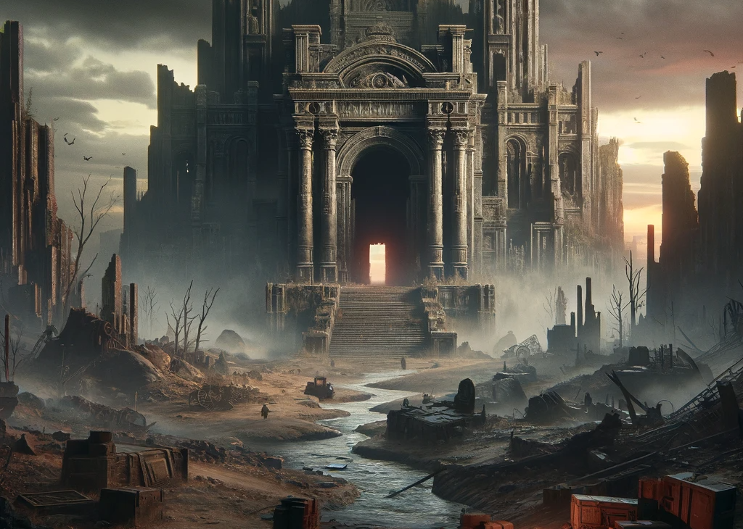
The Labyrinth of Darkness
Navigating the Shadows: Strategy and Survival in the Labyrinth of Darkness
APS145-NJJ
ABCEDI ILACAS
138180211
Notes:
The Labyrinth of Darkness
Navigating the Shadows: Strategy and Survival in the Labyrinth of Darkness

Slide 2
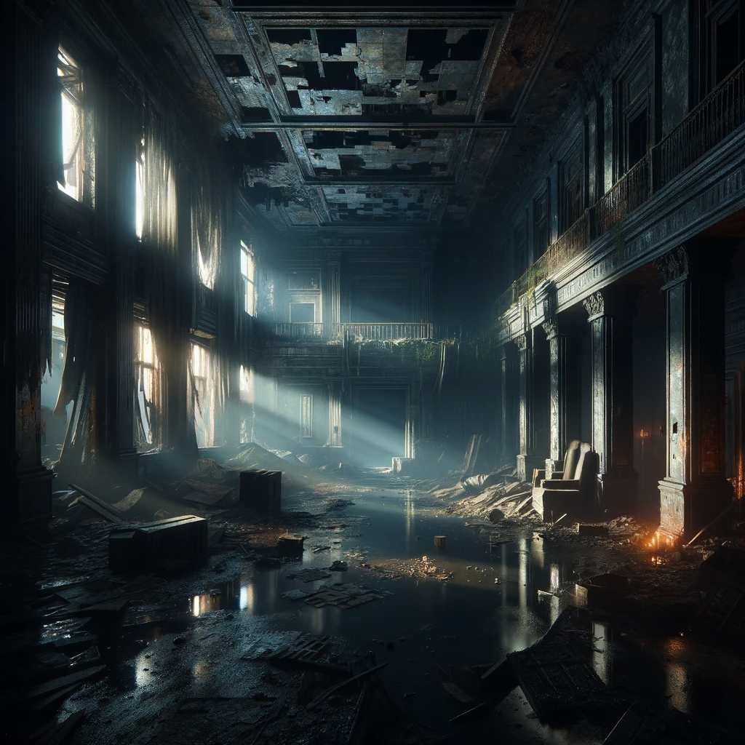
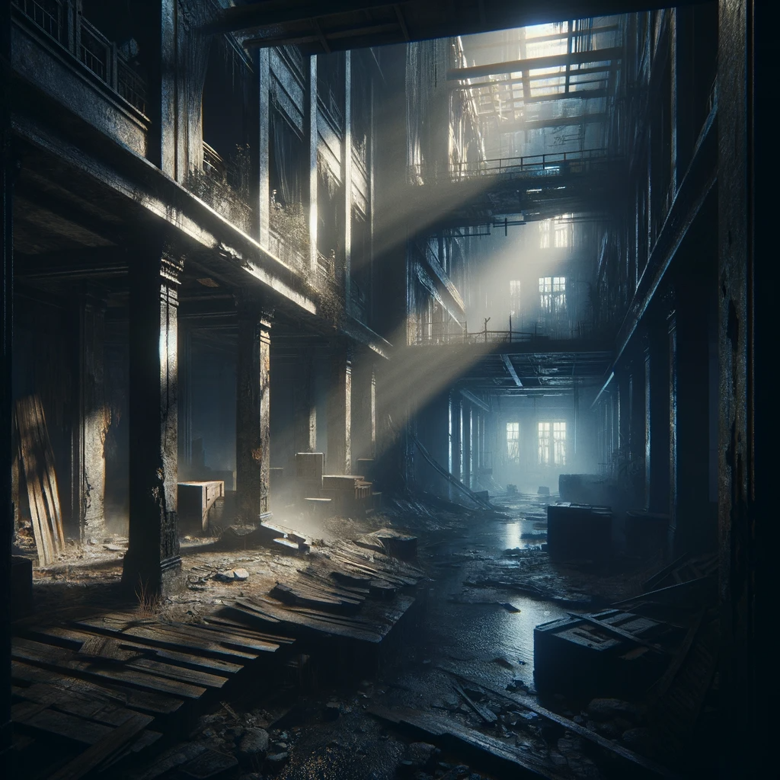
Introduction
Post-Apocalyptic World
Remnants of the Past
Edge of the Unknown
Abandoned Building: A Dark Labyrinth
A Test of Courage and Wit
Journey Through Darkness
Secrets and Challenges Await
Notes:
Introduction
"Imagine a world shrouded in the aftermath of an apocalypse, where remnants of the past linger in the shadows. We find ourselves at the precipice of an abandoned building, its corridors veiled in darkness. This is no ordinary exploration; it's a venture into the unknown, a test of courage and wit in a world where light is a luxury. Today, I invite you on a journey through this labyrinth, a maze that holds secrets and challenges at every turn."

Slide 3
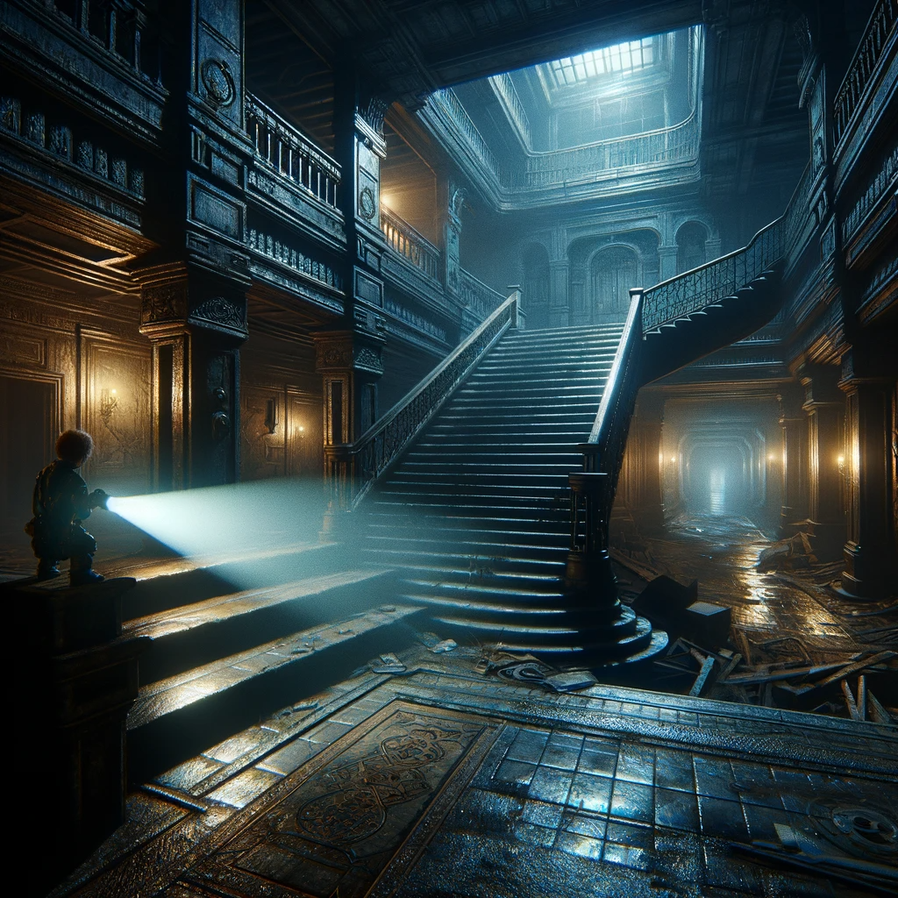
Objective and Setting
Starting Point: Foot of the Staircase
Enigmatic Hallways and Dark Mysteries
Darkness: More Than Absence of Light
Objective: Explore and Uncover Secrets
Essential Tool: The Flashlight
Challenge: Return Before Darkness Prevails
Beyond Physical Exploration: Decision-Making and Resource Management
Notes:
Objective and Setting
"Our quest begins at the foot of a staircase, the gateway to a network of enigmatic hallways. Here, the darkness is not just an absence of light, but a presence that cloaks potential discoveries and dangers alike. Armed with nothing but a flashlight, our objective is clear yet daunting: explore the depths of this forsaken building, uncover its hidden rooms, and return before our only source of light fades. This journey is not just about traversing physical spaces; it's about navigating the intricate maze of decision-making and resource management."

Slide 4
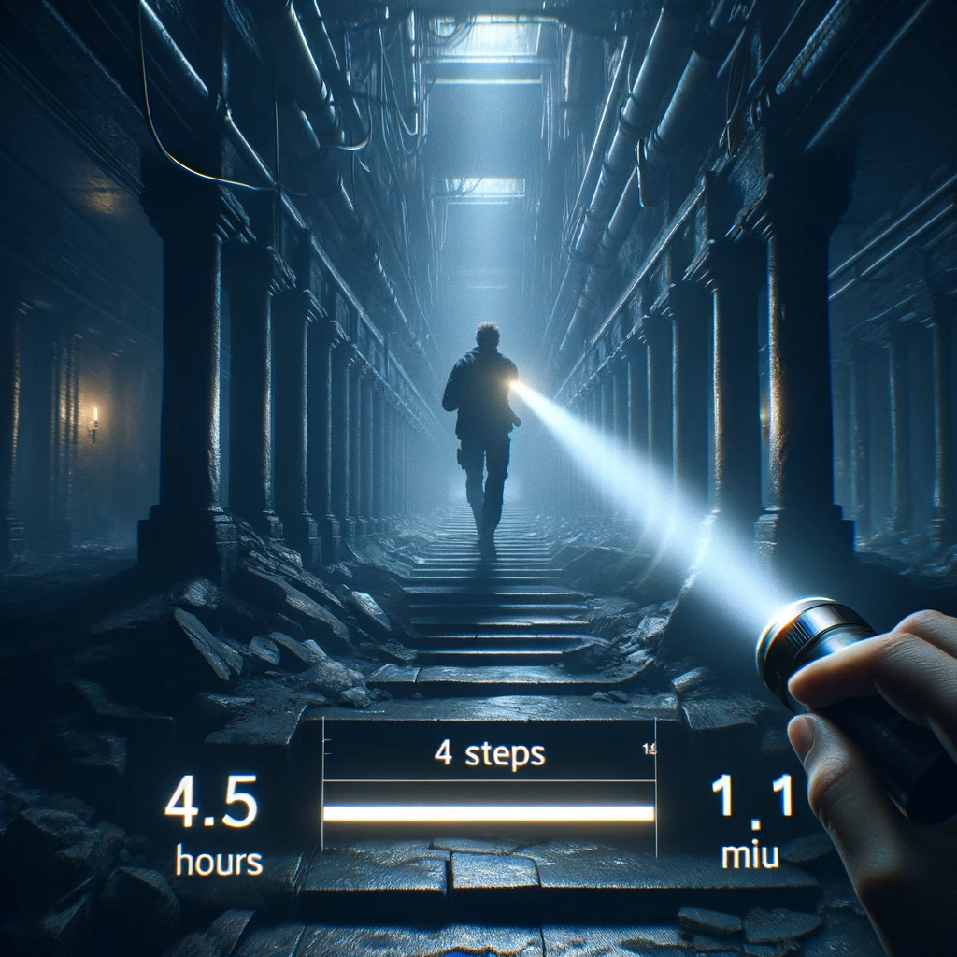
Game Mechanics
Flashlight: 4.5 Hours of Light
Each Step Counts: Four Steps Per Move
Time Management: 1.5 Minutes Per Move
Hallways: Sixty Steps of Unknown
Beacon in the Dark: Flashlight as Guide
Mental Agility: Calculating Battery Life vs. Distance and Time
Navigating with Precision: The Essence of the Game
Notes:
Game Mechanics
"In the heart of this labyrinth, each step and minute carries weight. Our journey is dictated by the life of our flashlight, a mere 4.5 hours. We tread cautiously, with each movement forward encompassing four steps, consuming one and a half minutes of our precious time. As we navigate the sixty-step hallways, the flashlight's glow is our beacon, guiding our path and decisions. The labyrinth demands not only physical movement but mental agility, as we must constantly calculate our battery life against the distance covered and the time elapsed."

Slide 5
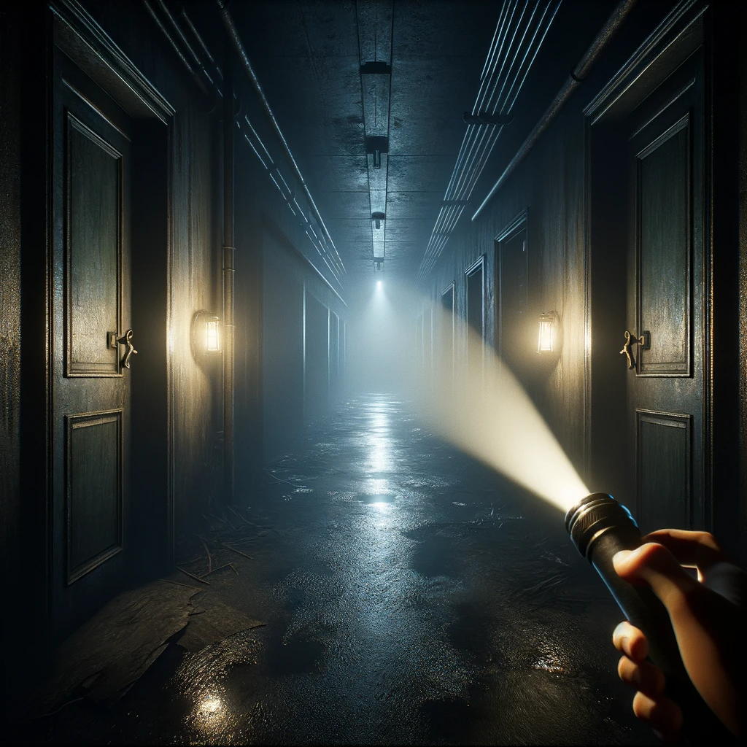
Strategy and Decision Making
Strategic Endeavor: Every Choice Matters
Critical Decisions: Left, Right, or Straight Ahead
Track Steps: Essential for Safe Return
Irreversible Choice: When to Turn Around
Balancing Curiosity with Caution
Risk vs. Reward: The Delicate Dance
The Threat of Darkness: Consequence of Overstepping
Notes:
Strategy and Decision Making
"This is more than a mere walk in the dark; it's a strategic endeavor where every choice can lead to discovery or demise. Our decisions at each hallway's end – to turn left, right, or continue straight – are pivotal. We must meticulously track our steps, foreseeing the need to retrace them for a safe return. The decision to turn around is irreversible, a critical point where we must weigh our curiosity against the waning light of our flashlight. It's a delicate dance of risk and reward, where overstepping can mean being engulfed by darkness."

Slide 6
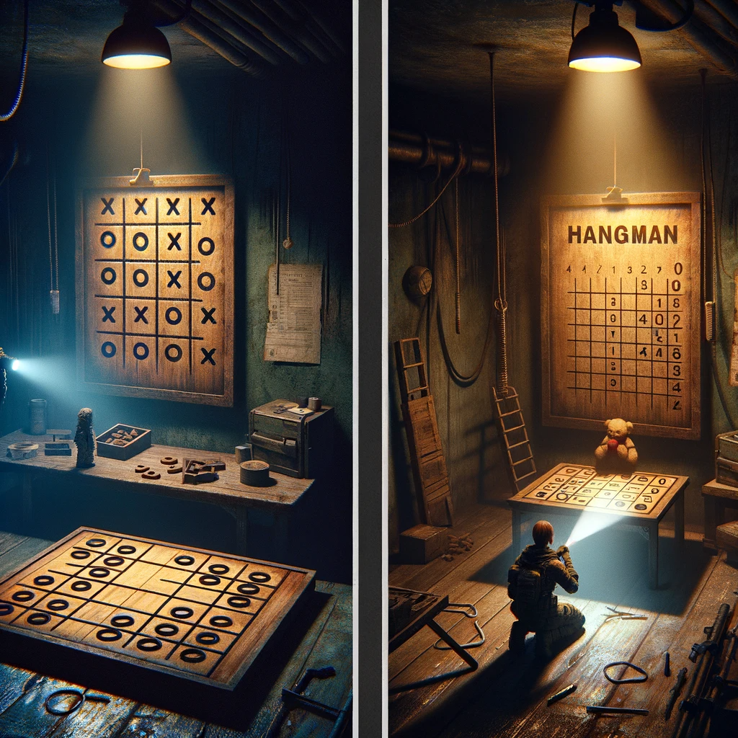
Mini Games and Time Management
Hidden Rooms: A Momentary Escape
Mini-Games: 'X's and O's' & 'Hang-Person
Choice Impact: Engage or Explore Further
Time: The Currency of Survival
Impact of Winning or Losing
Complex Resource Management
Joy vs. Necessity: Conserving Flashlight Power
Notes:
Mini-Games and Time Management
"In this labyrinth, rooms hidden within the maze offer a brief respite in the form of mini-games: 'X's and O's' and 'Hang-Person'. Each room discovered presents a choice – to engage in these games or continue exploring. These are not just games; they represent critical decisions as each one consumes time – the currency of our survival. Winning or losing, each game affects our time differently, adding a layer of complexity to our resource management. Balancing the joy of these games with the necessity to conserve flashlight power is a delicate task."

Slide 7
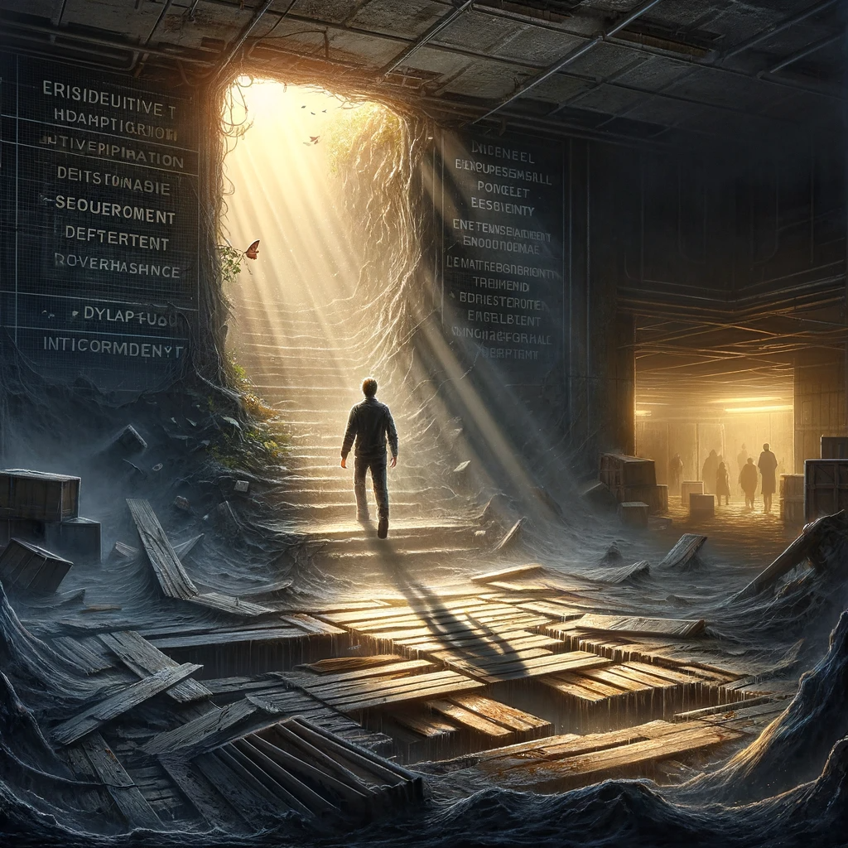
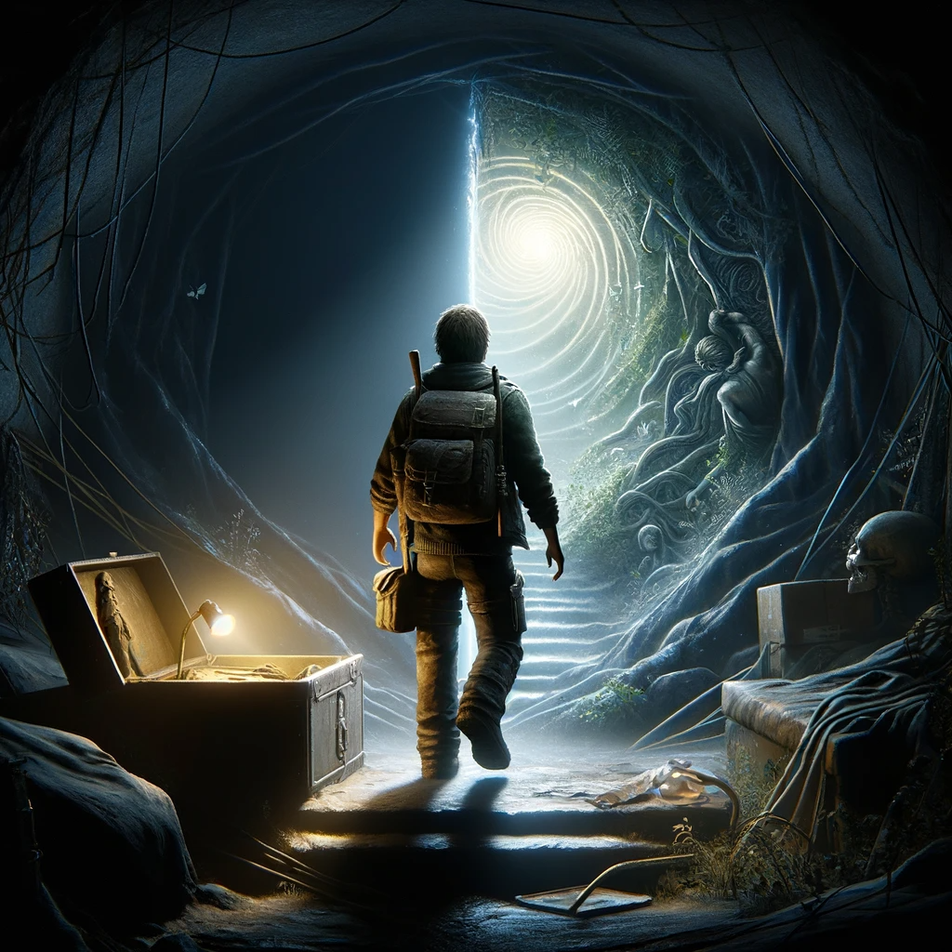
Conclusion
Beyond a Game: A Metaphor for Life's Challenges
Strategic Decisions & Risk Management
Resource Allocation & Problem-Solving
Balancing Risk and Reward
Resilience and Adaptability
Power of Calculated Choices
Notes:
Conclusion
"As we emerge from the shadows of the labyrinth, our journey reflects more than just a game. It's a metaphor for life's challenges, where strategic decisions, risk management, and resource allocation play pivotal roles. This exploration teaches us the essence of problem-solving – balancing risk with reward, planning with spontaneity, and light with darkness. It's a lesson in resilience, adaptability, and the power of calculated choices.

Slide 8
Thank you for joining me on this enlightening journey through the Labyrinth of Darkness.
Notes:
Thank you for joining me on this enlightening journey through the Labyrinth of Darkness."

